Slide 1



DATA ANALYTICS BOOTCAMP
NBA ANALYTICS

Slide 2

Presentation Overview
Points of Discussion
DATA COLLECTION
DATA ANALYSIS
CONCLUSION
By: Benyam Gizaw, Jose Roncal, and
Heather Bivona

Slide 3

Our project is to uncover correlations within data regarding the active players in the NBA. We'll examine how age affects performance, as well as how the player positions correlate with points scored and how turnovers correlate with minutes played , as the data admits

Slide 4

Questions & Data
DOES AGE AFFECT THE PLAYERS PERFORMANCE?
HOW POSITION AFFECTS PERFORMANCE?
DOES TURNOVERS POSITIVELY/NEGATIVELY CORRELATE WITH FOULS AND MINUTES PLAYED?
SOURCE:
https://www.basketball-reference.com/leagues/NBA_2019_per_game.html

Slide 5

DATA ANALYSIS

Slide 6

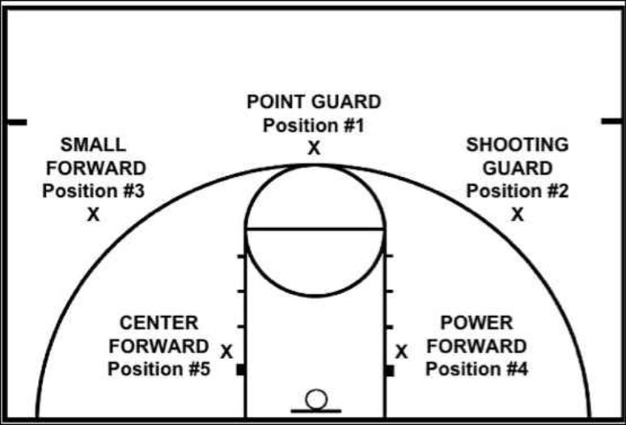
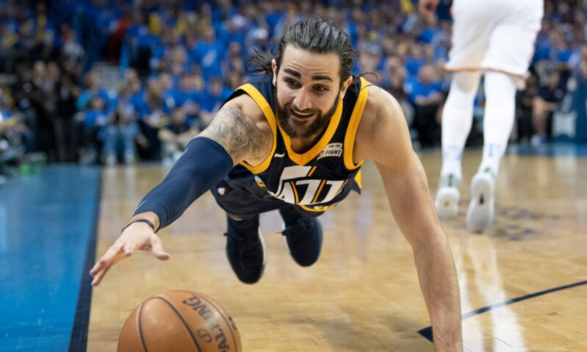
GLOSSARY
POSITIONS
TURNOVER

Slide 7
POSITION

Slide 8

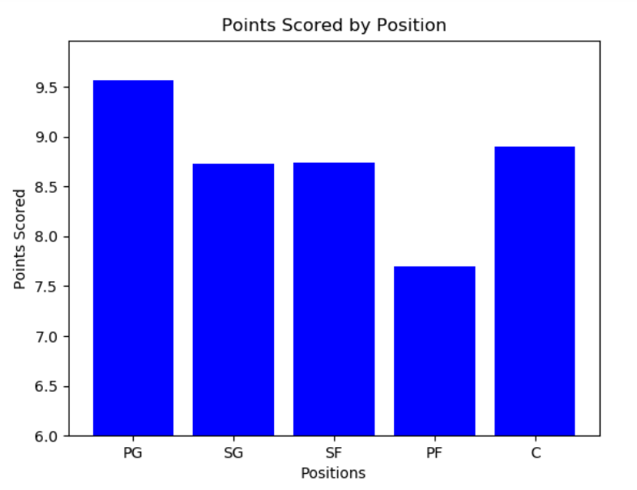
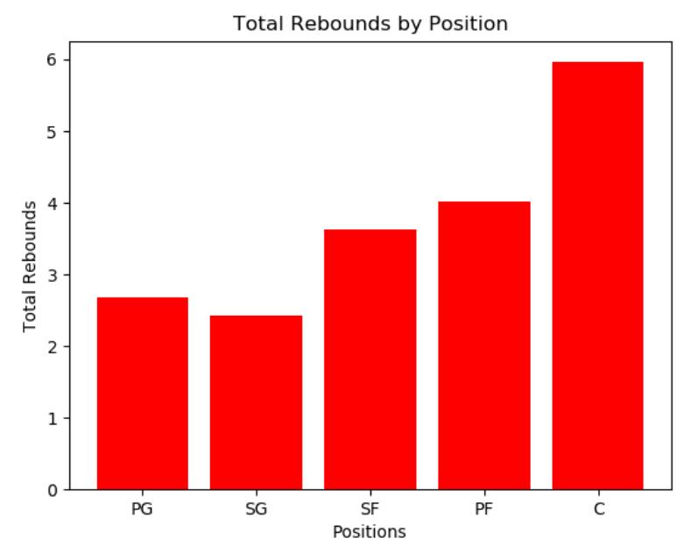
POSITION
VS
POINTS SCORED
POSITION
VS
TOTAL REBOUNDS

Slide 9
AGE

Slide 10
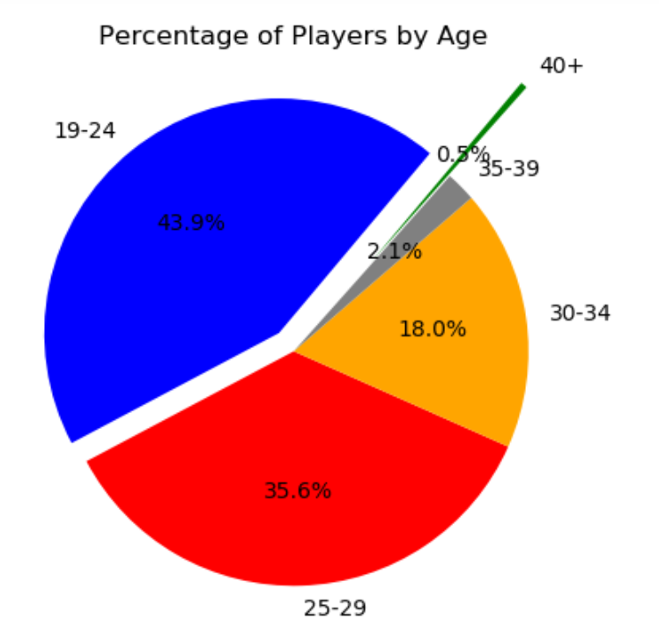

ACTIVE PLAYERS'S
AGE

Slide 11

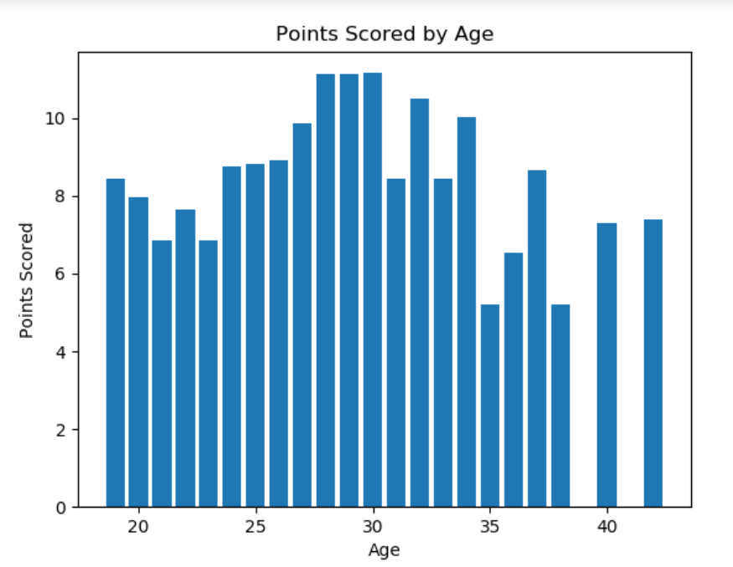
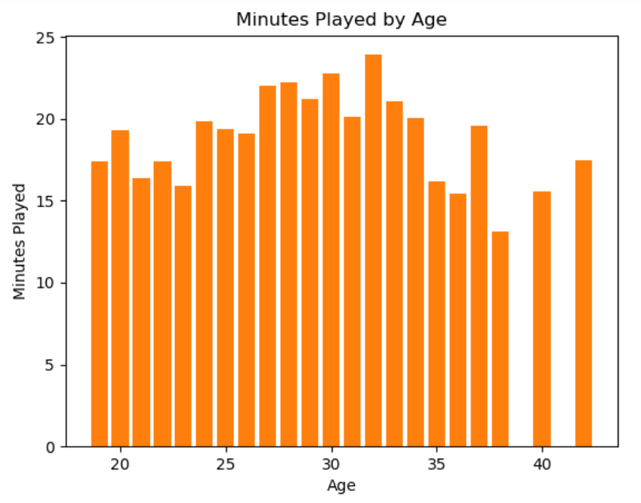
POINTS SCORED VS
AGE
MINUTES PLAYED VS
AGE

Slide 12
TURNOVERS

Slide 13

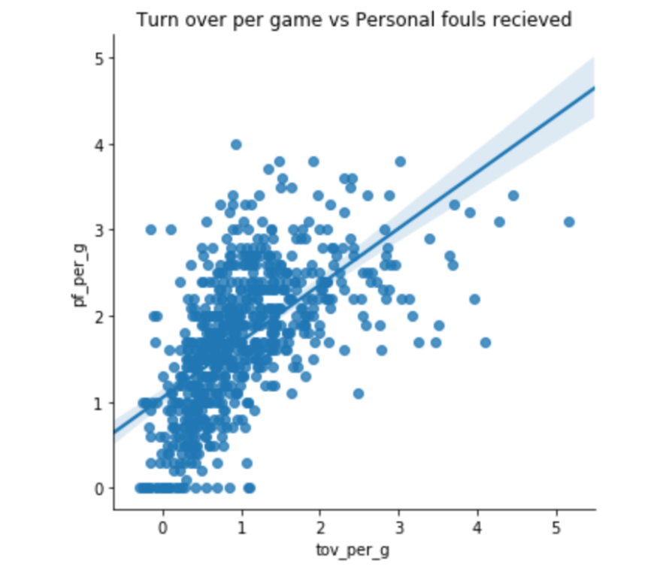
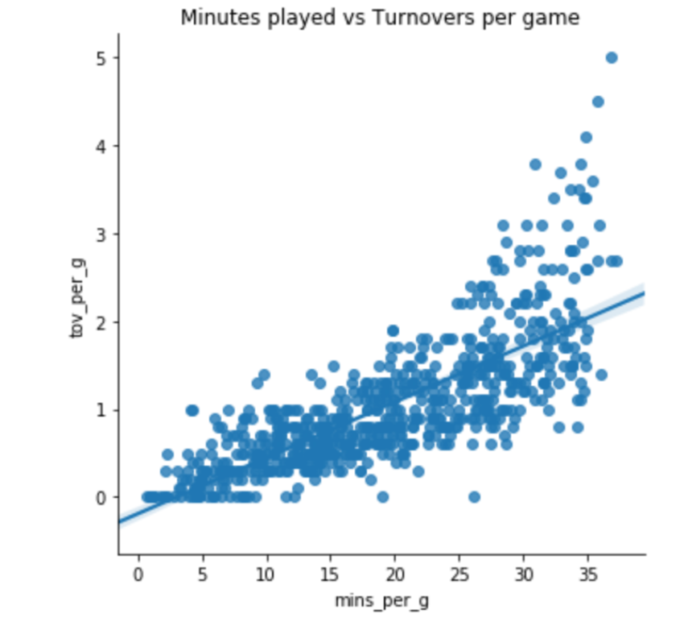
Turnovers per game
vs
Personal foul received
Minutes Played
vs
Turnovers per game

Slide 14


SUMMARY
POSITION
Our findings show that PG scores the most points on avrg per game while PF scores the least.
TURNOVERS
Our findings show a positive correlation with personal fouls and the amount of turnovers.
Also a positive correlation between minuted and turnovers.
AGE
Our findings show that most active players in the NBA are represented by the ages of 19-24.
Players in their 30's perform better.
Players from 35-45 play less.

Slide 15



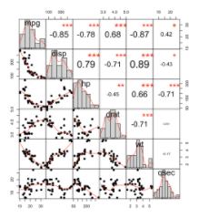


POST MORTEM
DATA COLLECTION
GRAPHS ISSUES
AMOUNT OF DATA
SALARIES?

Slide 16

THANK YOU!
ANY QUESTIONS?

